Slide 1

PaccMann: explainable multimodal drug sensitivity prediction
IBM Research
Notes:
Introductory information, maybe a couple of jokes
Let's start...

Slide 2
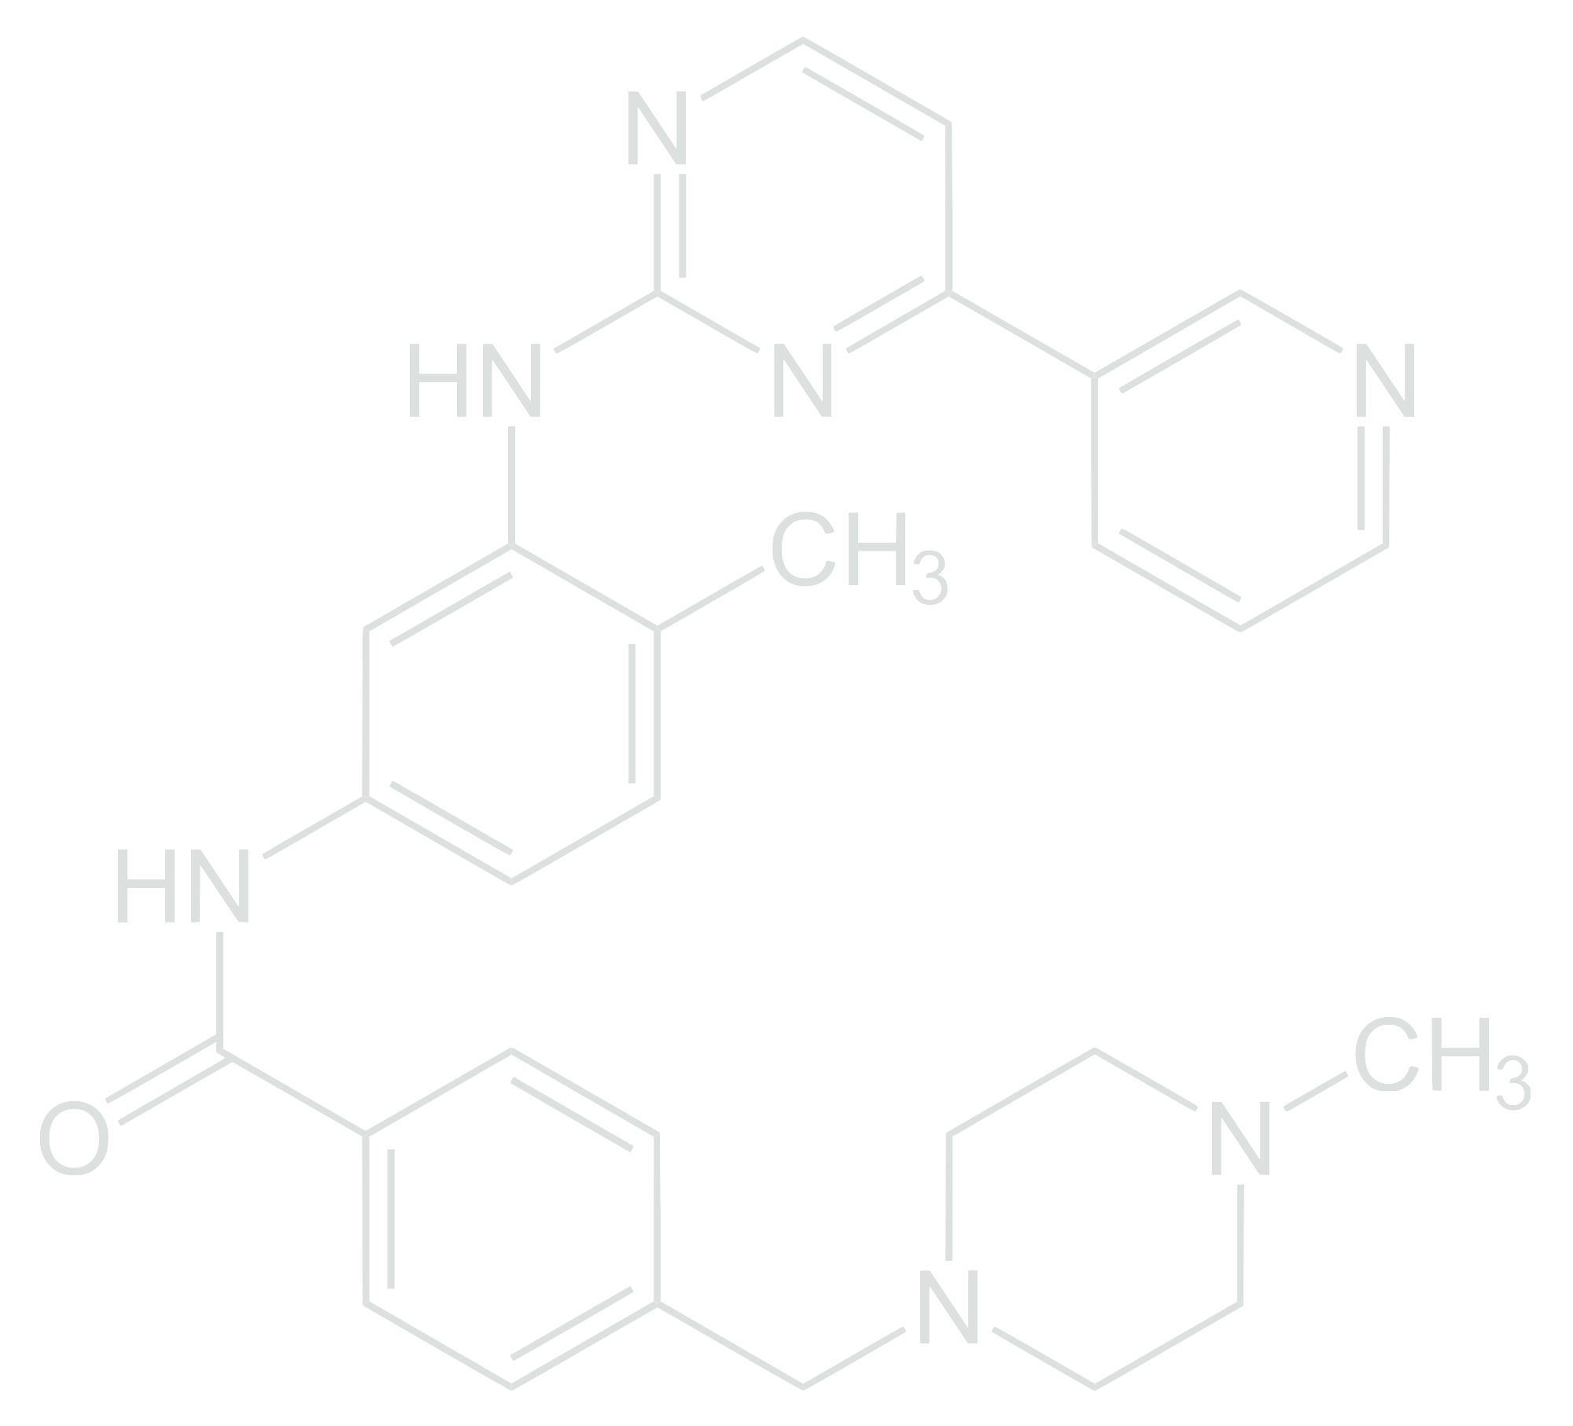
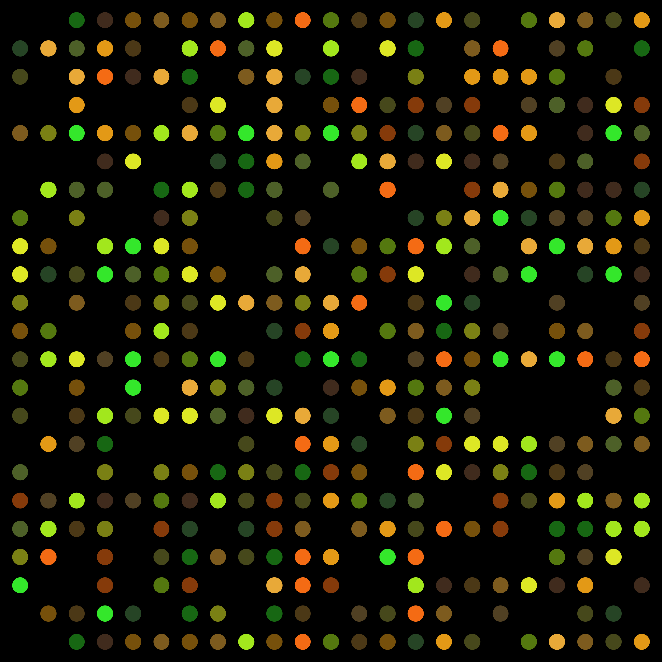
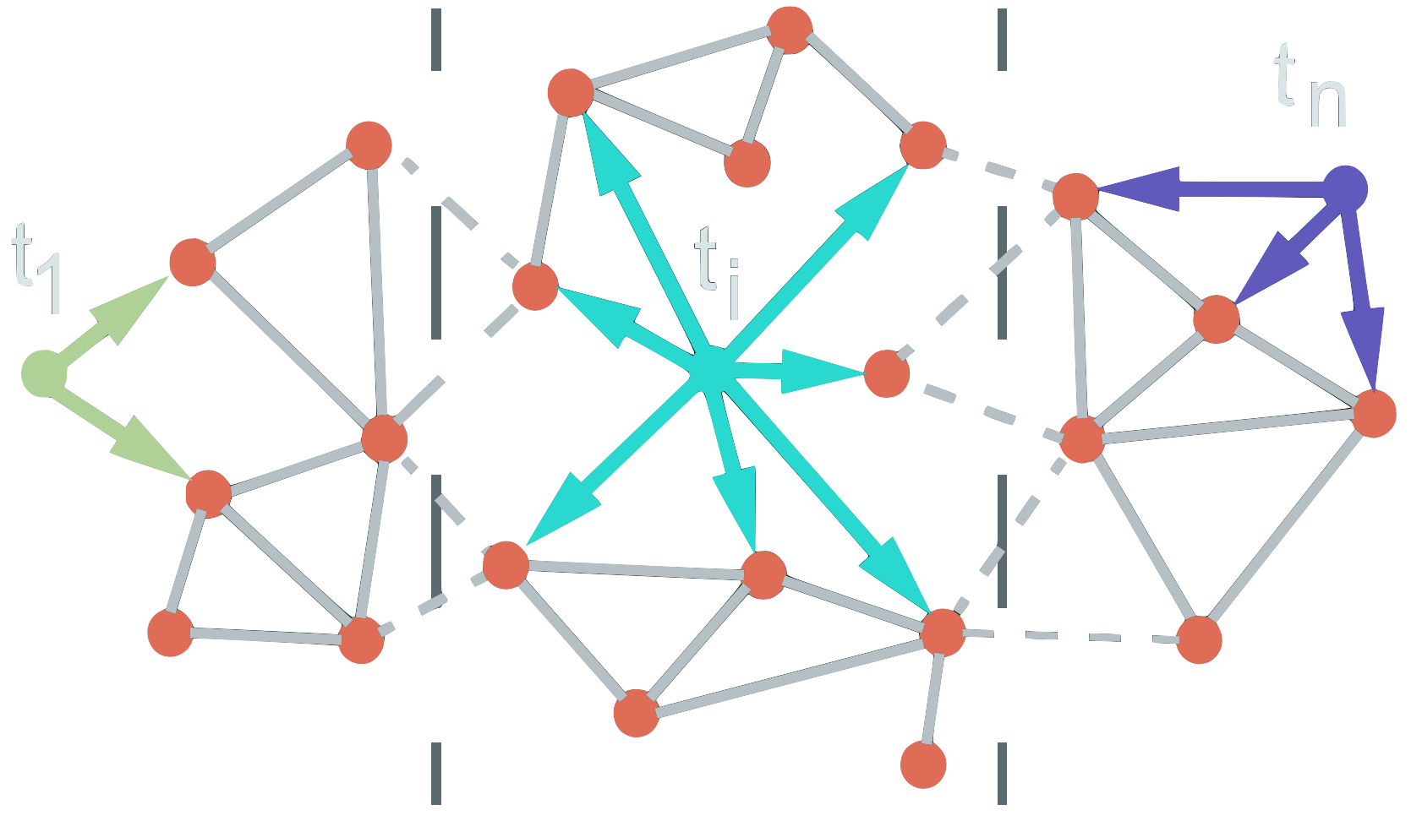
Drug sensitivity prediction
IC50
Complex combination of multiple factors:
Compound’s structure
Biomolecular landscape of the cell line
Protein-protein interaction
Need for explainable methodologies to understand
the prediction on both omic and chemical level
Interpretability for deep learning / © 2020 IBM Corporation
Manica M. et al., Molecular Pharmaceutics 2019 16 (12) DOI: 10.1021/acs.molpharmaceut.9b00520

Slide 3
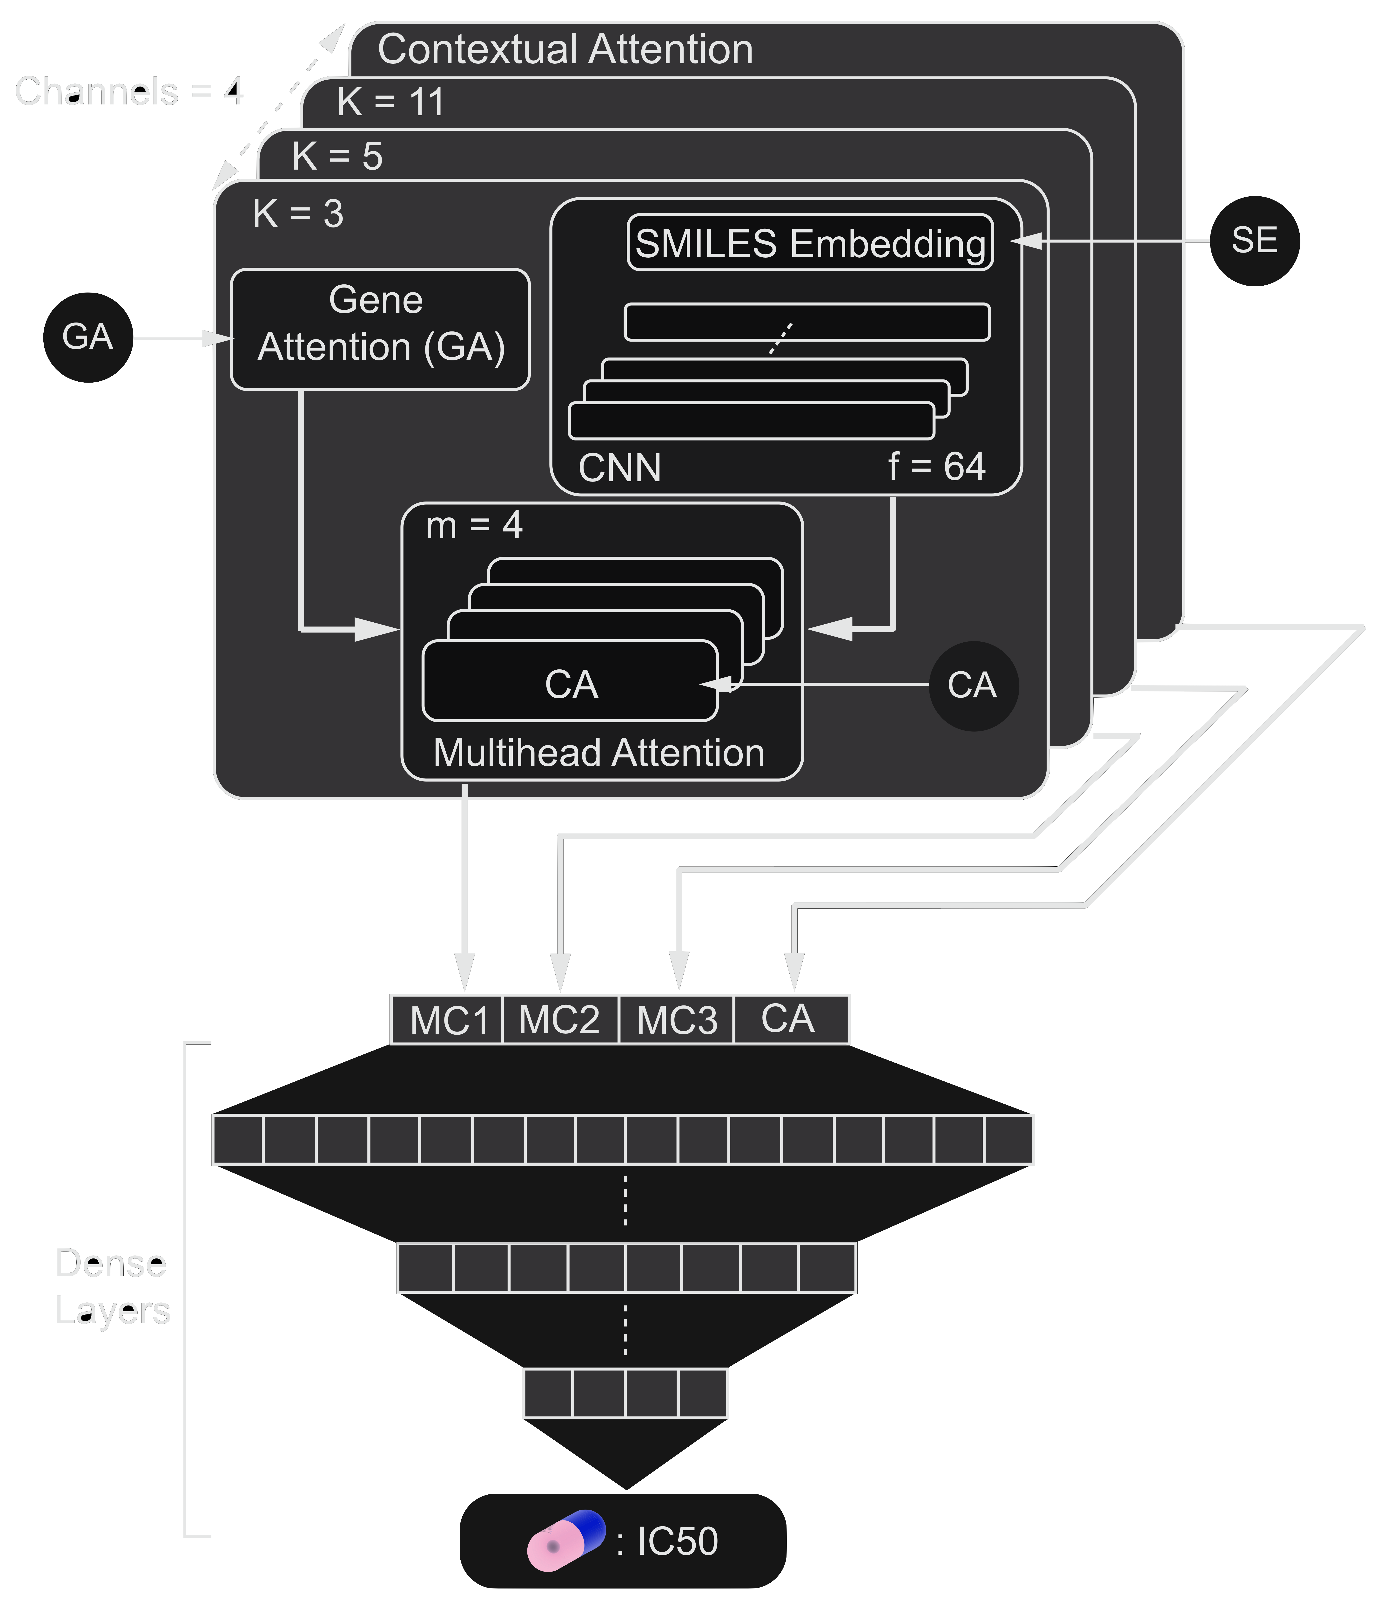
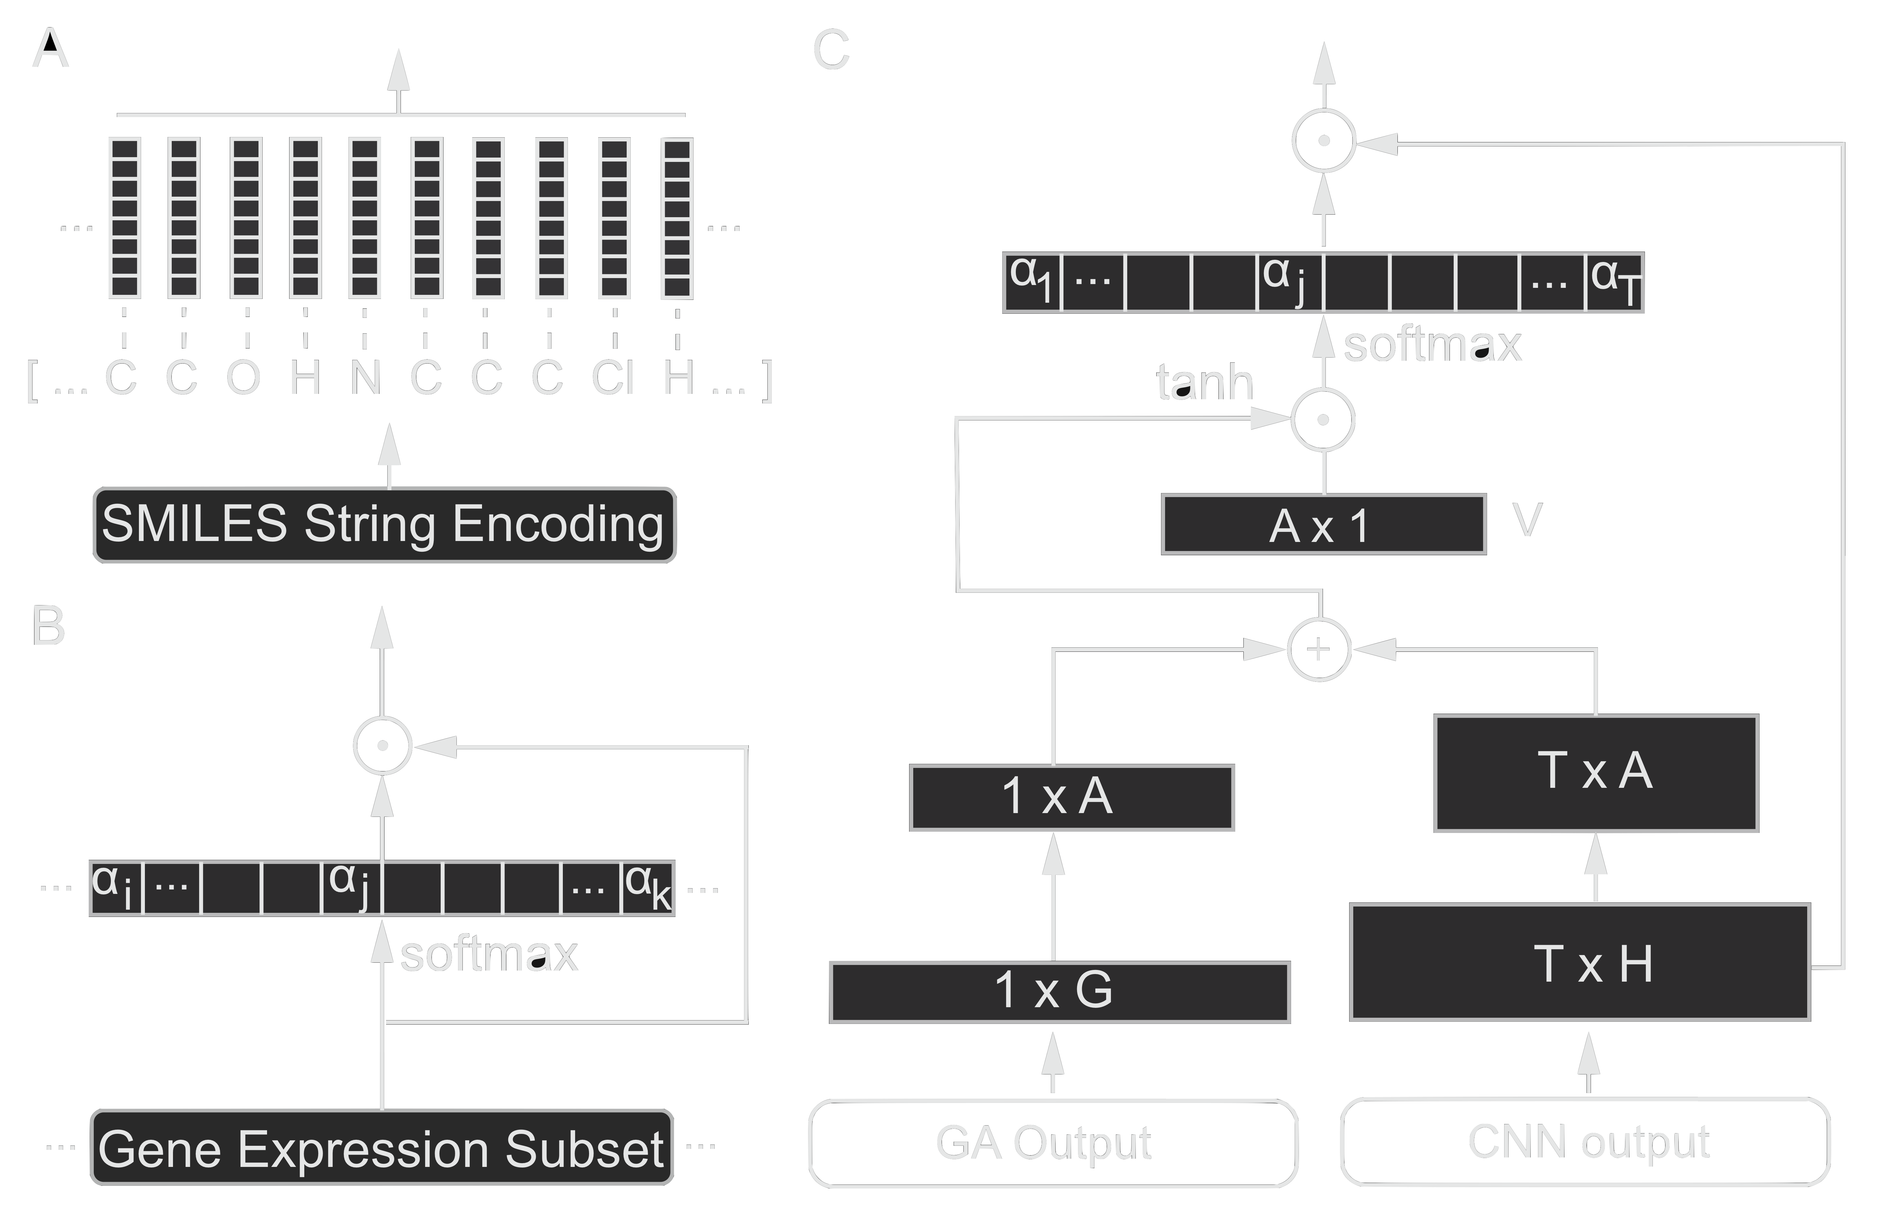
PaccMann - model architecture
A contextual attention mechanism lets the network focus on relevant genes and molecules’ substructures
Interpretability for deep learning / © 2020 IBM Corporation
Manica M. et al., Molecular Pharmaceutics 2019 16 (12) DOI: 10.1021/acs.molpharmaceut.9b00520

Slide 4
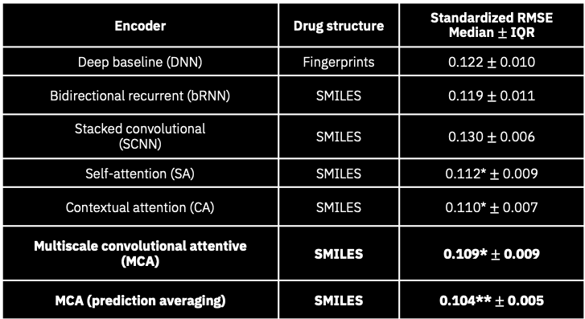
PaccMann - benchmarking
PaccMann outperforms state-of-the-art methods that exploit hand engineered features as well as different deep learning architectures
Encoder | Drug structure | Standardized RMSE Median $±$ IQR
Deep baseline (DNN) | Fingerprints | 0.122 $±$ 0.010
Bidirectional recurrent (bRNN) | SMILES | 0.119 $±$ 0.011
Stacked convolutional (SCNN) | SMILES | 0.130 $±$ 0.006
Self-attention (SA) | SMILES | 0.112* $±$ 0.009
Contextual attention (CA) | SMILES | 0.110* $±$ 0.007
Multiscale convolutional attentive (MCA) | SMILES | 0.109* $±$ 0.009
MCA (prediction averaging) | SMILES | 0.104** $±$ 0.005
Interpretability for deep learning / © 2020 IBM Corporation
Manica M. et al., Molecular Pharmaceutics 2019 16 (12) DOI: 10.1021/acs.molpharmaceut.9b00520

Slide 5
PaccMann - compound attention
High
Masitinib
Low
PaccMann identifies relevant structural elements for efficacy prediction (significant correlation with Tanimoto similarity)
Imatinib
Interpretability for deep learning / © 2020 IBM Corporation
Manica M. et al., Molecular Pharmaceutics 2019 16 (12) DOI: 10.1021/acs.molpharmaceut.9b00520

Slide 6
PaccMann - gene attention
MEG-01
High
Low
PaccMann highlights relevant genes for efficacy prediction (significant enrichment of Apoptosis/cell death pathway)
Interpretability for deep learning / © 2020 IBM Corporation
Manica M. et al., Molecular Pharmaceutics 2019 16 (12) DOI: 10.1021/acs.molpharmaceut.9b00520

Slide 7
PaccMann - availability
IBM Cloud
https://ibm.biz/paccmann-aas
GitHub
PaccMann/paccmann_predictor_tf
Data
https://ibm.biz/paccmann-data
Interpretability for deep learning / © 2020 IBM Corporation
Manica M. et al., Molecular Pharmaceutics 2019 16 (12) DOI: 10.1021/acs.molpharmaceut.9b00520

Slide 8
IBM sign-off
IBM Research

